Slide 1

HOTEL MANAGEMENT SYSTEM
Submitted By :
Ahmed Mustafa Amlan
2021-3-60-253
Abrar Hossain Zahin
2022-2-60-040
Farhana Rahman Munira
2021-3-60-153
HOTEL NIRVANA
EXPERIENCE ULTIMATE BLISS

Slide 2

Introduction
Welcome to the Hotel Nirvana Management App! Our innovative app is designed to revolutionize hotel operations by streamlining tasks and enhancing guest experiences With user-friendly features powered by SQL, our app ensures management of reservations, check-ins, billing, and more. Join us as we explore how this cutting-edge technology transforms Hotel Nirvana into a leader in modern hospitality.

Slide 3
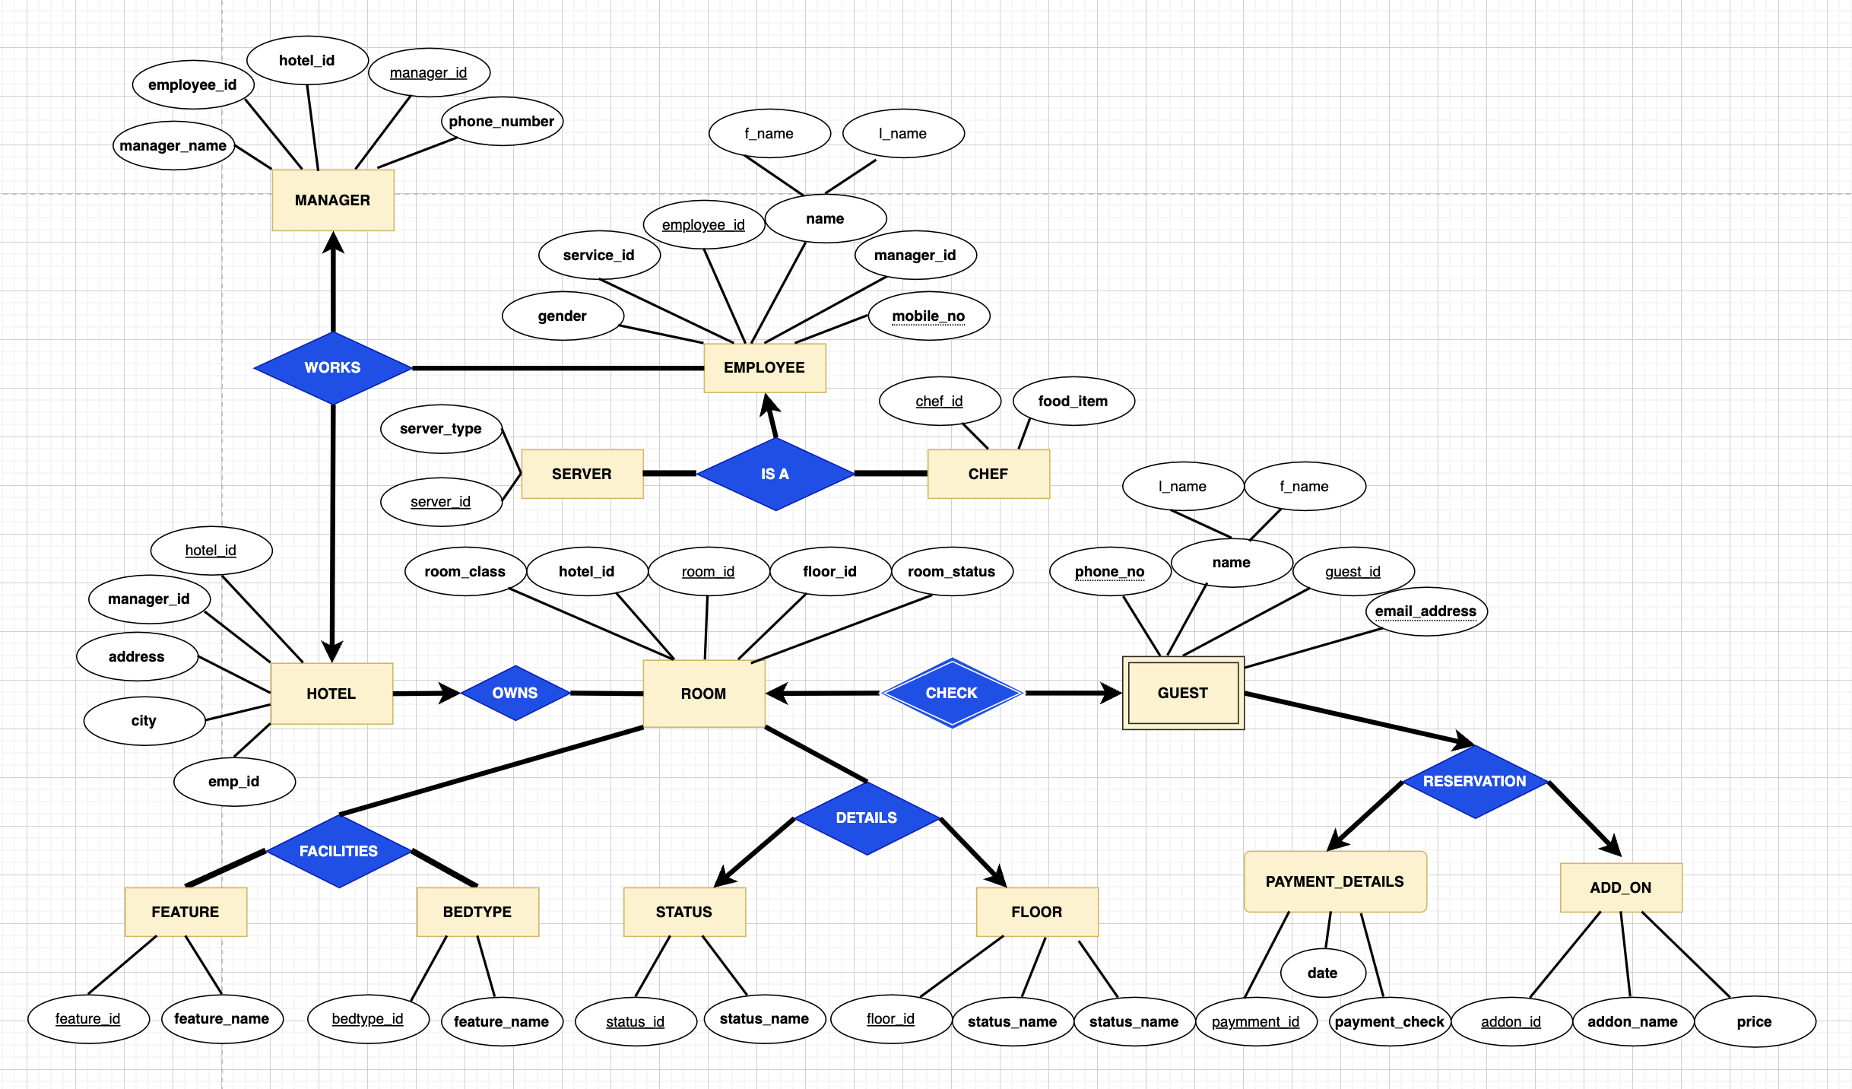
E-R DIAGRAM

Slide 4
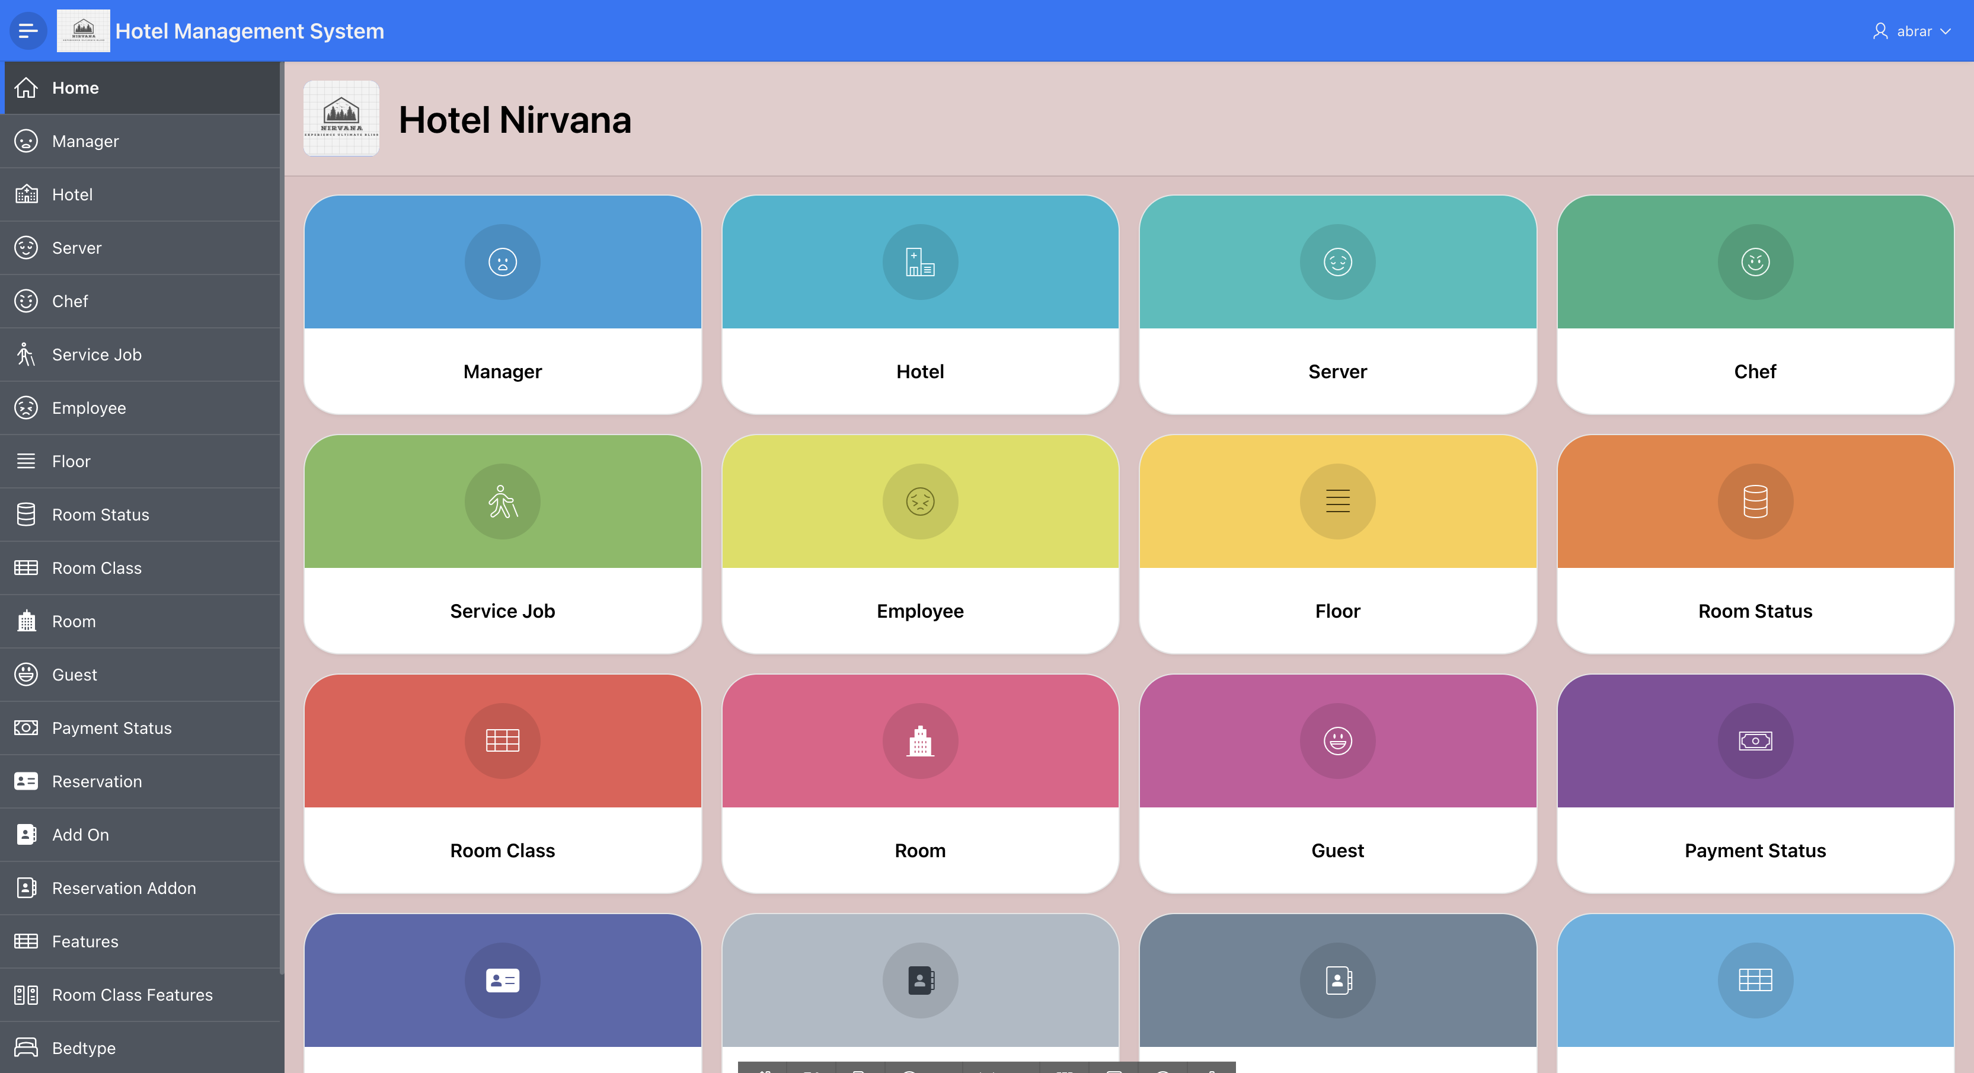
Home Page
CONSISTS OF 19 TABLE FORMS AND REPORTS

Slide 5
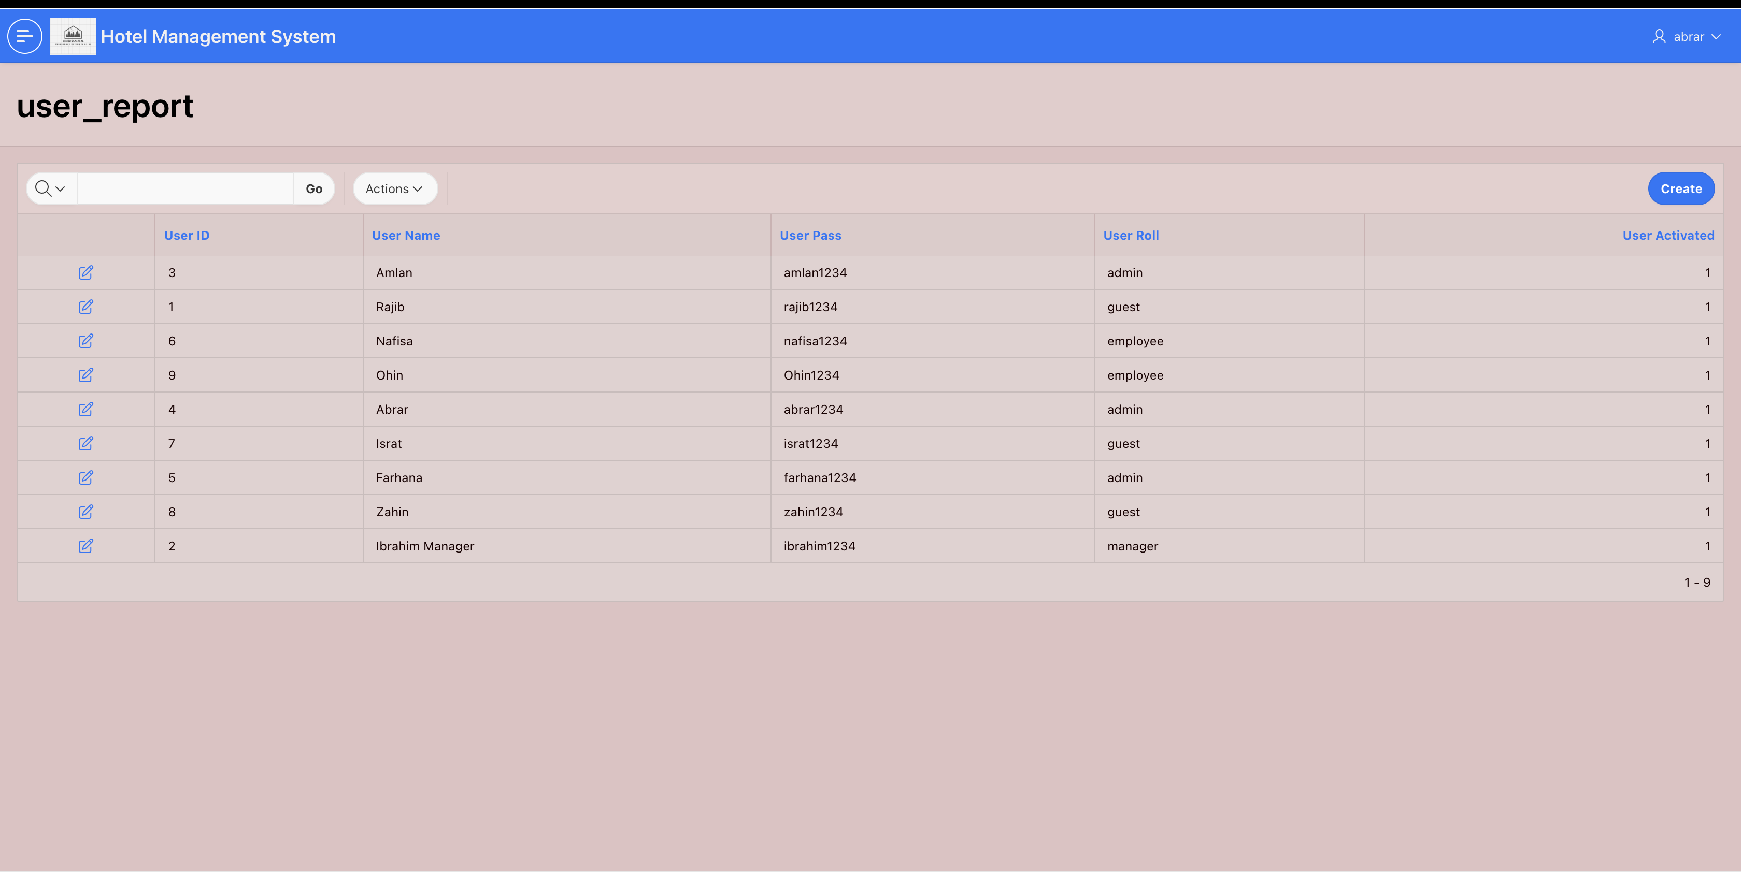
AUTHENTICATION
*Only Administrators have access

Slide 6
AUTHORIZATION
1) ADMIN
USER_TABLE
EMPLOYEE
2) MANAGER
GUEST
SERVER
3) EMPLOYEE
CHEF
4) GUEST
VIEW ONLY

Slide 7
System Feature
Online Booking System
POS And Payement In- tegration
Housekeeping Management
Feedback and Reviews
Revenew Managament
Promotions and Discounts

Slide 8

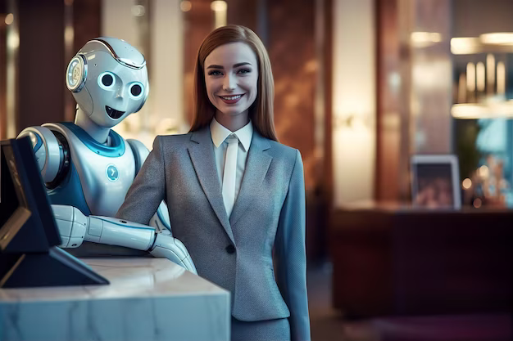
Future Enhancemments
The future of our hotel management systems is promising, with emerging technologies like Virtual Reality (VR) for immersive virtual tours and Artificial Intelligence (AI) combined with Cloud-Based Hotel Management Software. These innovations aim to streamline operations and enhance guest experiences12. Additionally, smart hotels are leveraging AI, AR, and digital connectivity to empower customers and put them in control3

Slide 9

Implementation
Creating And Desiging Software
Designing UI aka Website
Creating Local Database using sql code in oracle apex
Creating tables and using role and permission
Connecting Database to UI website

Slide 10
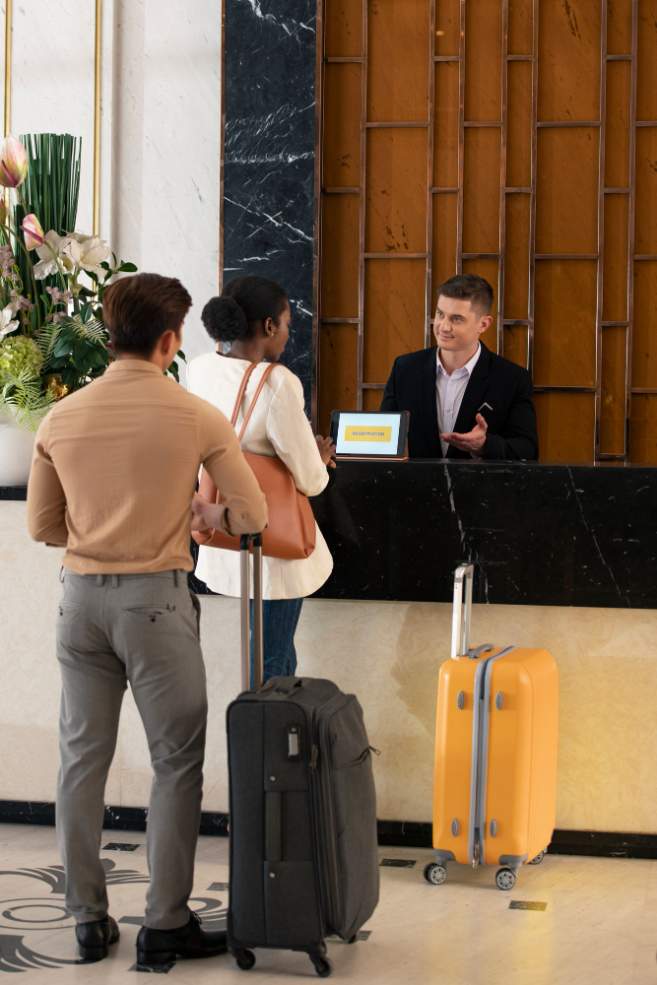

Benefits
Time Saving : Automates repetitive tasks
Accuracy : Reducing human errors
Improved Service : Enhances guest experiences

Slide 11


Conclusion
Our Hotel Management System
Streamlines reservation, room customization, and payment processes. Built on an Oracle database with an ASP and Visual Basic interface, it enhances efficiency and user experience.”

Slide 12





Thank You!
We respect your valuable time !
If you have any questions, please reach us

